Slide 1

Exploratory Data Analysis on AMCAT dataset
by Ritam Paul (IN9240185)

Slide 2
About me
Background :
1. Completed 10+2 from cbse board in pure science stream
2. Currently in final year of B.Tech
Reason to learn Data Science :
1. Have efficiency in python3
2. Always have interest in AI domain
Work experience :
1. Fresher, no prior experience
Social media profile urls :
1. Github = link
2. LinkedIN = link

Slide 3
Agenda
Objective of the Project
Data collection
Summary of the Data
Exploratory Data Analysis:
Data Cleaning
Data Manipulation
Univariate Analysis
Bivariate Analysis
Key Business Question & their solutions

Slide 4
Objective of the Project :
Exploratory Data Analysis on AMCAT dataset.
Data collection :
Download link = link
Summary of the data :
The dataset was released by Aspiring Minds from the Aspiring Mind Employment Outcome 2015 (AMEO). The study is primarily limited only to students with engineering disciplines. The dataset contains the employment outcomes of engineering graduates as dependent variables (Salary, Job Titles, and Job Locations) along with the standardized scores from three different areas – cognitive skills, technical skills and personality skills. The dataset also contains demographic features. The dataset contains around 40 independent variables and 4000 data points. The independent variables are both continuous and categorical in nature. The dataset contains a unique identifier for each candidate. Below mentioned table contains the details for the original dataset.

Slide 5
Exploratory Data Analysis
Data Cleaning:
Removing the no impact fields or unnamed fields (example: ID).
Data Manipulation :
Changing the data type of certain columns (example: DOB from string to datetime).
Univariate Analysis :
1. For numerical columns :
a. Checking outliers using boxplot.
b. Finding mean, median, mode, dispersion, iqr.
c. Probability and frequency distribution.
d. Finding skewness, kurtosis, mean-median relation.
2. For categorical columns :
a. Probability and frequency distribution.
b. Finding top most frequent categories in each column.

Slide 6
Exploratory Data Analysis
Bivariate Analysis :
1. For numerical columns :
a. Dsicovering relationship of all numerical column versus Salary using scatter plot.
b. Calculating correlation among all numerical column versus Salary in range [-1, 1].
c. Plotting correlation matrix of all numerical column versus Salary using heatmap.
2. For categorical columns :
a. Identifying the relation of all categorical column versus Salary using scatter plot.
b. Plotting the distribution of average salary versus all categories using bar plot.
c. Plotting relation between Date Of Joining and salary using stacked bar plot.

Slide 7
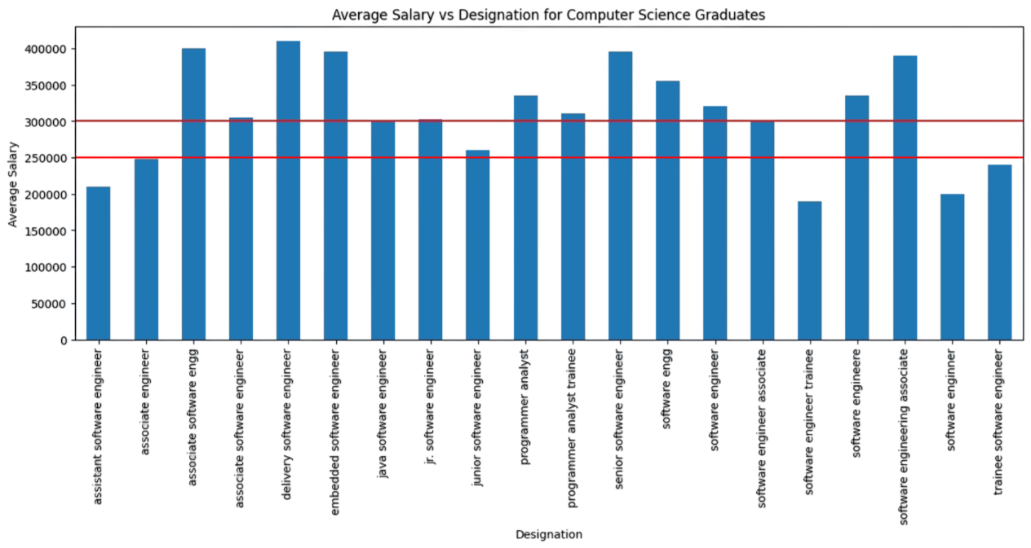
Key Business Question - 1
Times of India article dated Jan 18, 2019 states that “After
doing your Computer Science Engineering if you take up jobs as
a Programming Analyst, Software Engineer, Hardware Engineer
and Associate Engineer you can earn up to 2.5-3 lakhs as a fresh
graduate.” Test this claim with the data given to you.
Findings : It can be concluded from the bar plot that most of the designations among given choices have a true income of 2.5 – 3 lakhs except for “associate software engineer”, “associate engineer”, “software engineer trainee”, “software engineer”.

Slide 8
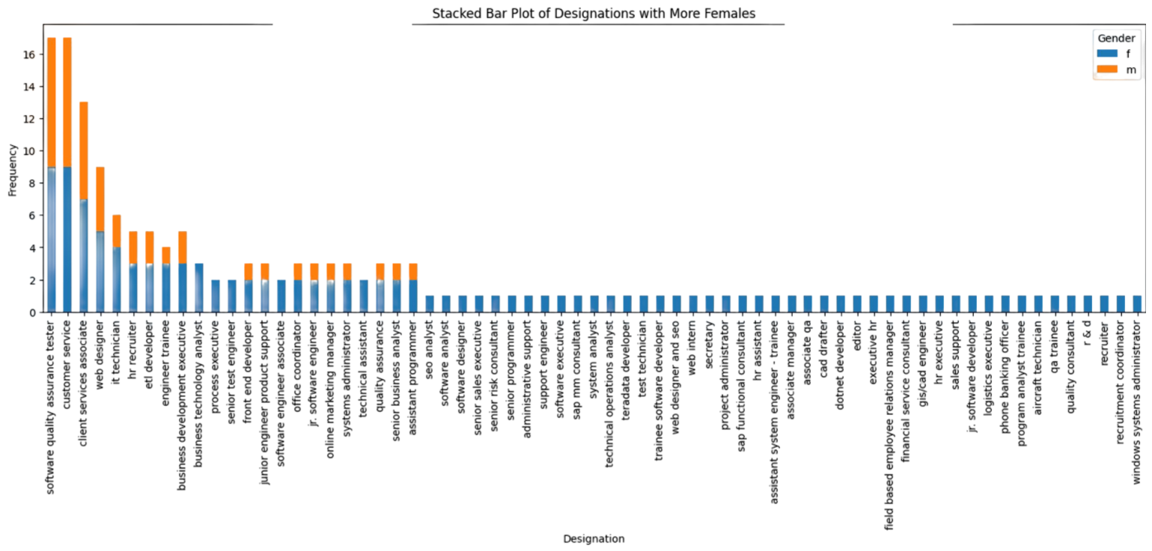
Key Business Question - 2
Is there a relationship between gender and
specialization? (i.e. Does the preference of
Specialisation depend on the Gender?)
Findings : It can be concluded surely that most of the designations have male count more than females. There are only 67 out of 419 unique designations that have females count more than males and the designation names can be observed clearly in the graph below.

Slide 9

THANK YOU

